Slide 1
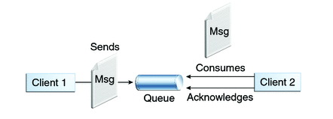

SpringBoot + JMS + RabbitMQ example
Queues [point-to-point]: Queue’s are based on point-to-point messaging model where messages are sent to a queue. Each message has exactly one sender and one receiver. Message is guaranteed to be delivered to only one receiver.
SpringJMSProducer Application
SpringJMSConsumer Application

Slide 2
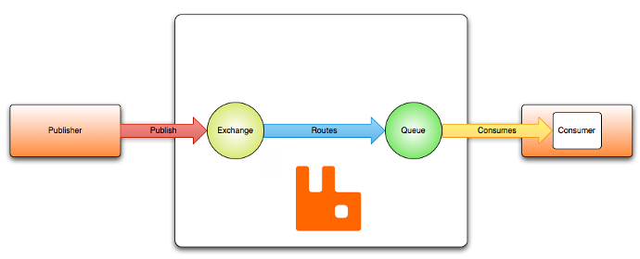
Routes the message to a queue
This is container for the messages.
SpringJMSProducer Application
SpringJMSConsumer Application

Slide 3
SpringBoot JMSProducer Application
RabbitTemplate: This is helper class to send and receive messages.
Binding: Binds the queue and topic exchange for a given queue name.

Slide 4
RabbitTemplate.convertAndSend method converts java object to AMQP message and is sent to default topic exchange.

Slide 6
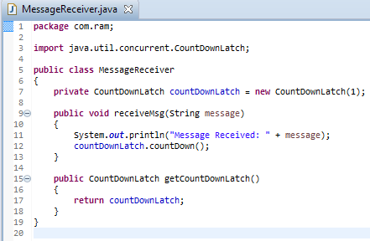
SpringBoot JMSConsumer Application
Receiver class that will receive the message. The method implemented to receive message should be acknowledged to MessageListenerAdapter in configuration class.

Slide 7
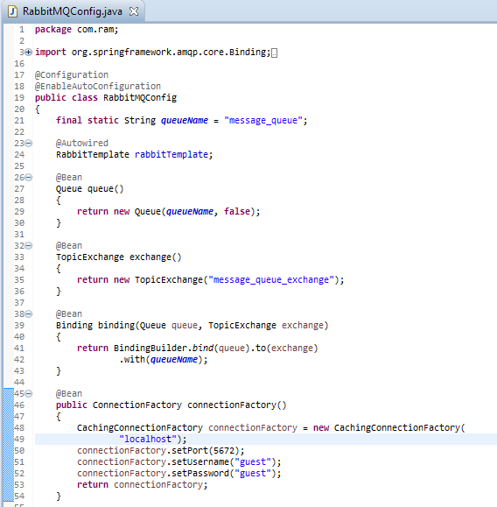
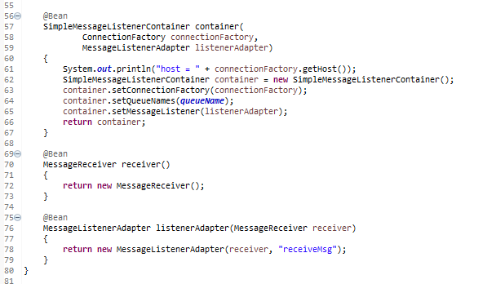
SpringJMSConsumer Application

Slide 8
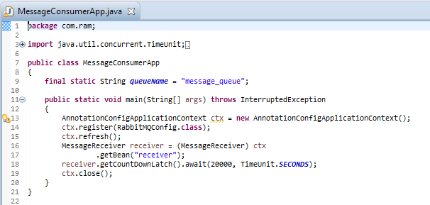
SpringJMSConsumer Application

